Slide 1
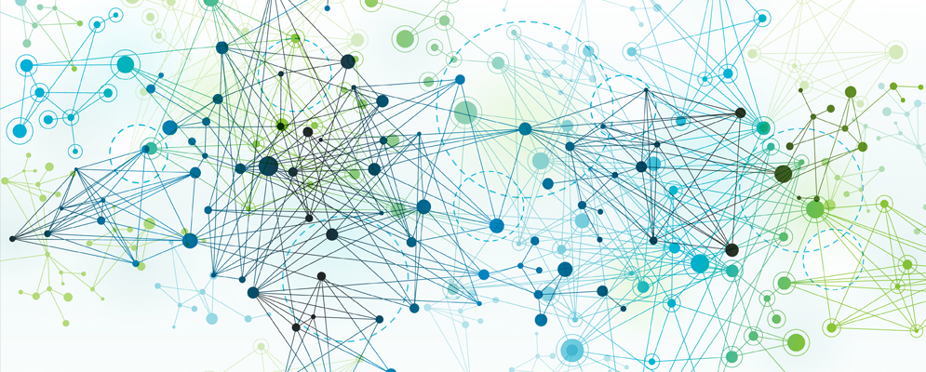
Python for AI and Machine Learning
AI vs Machine Learning
Marilson Campos
UCSC Extension - 2023

Slide 2
What is AI vs Machine Learning
What is artificial intelligence?
The capability of a system to mimic human cognitive functions such as learning and problem-solving.
What is machine learning?
It’s considered a subset of AI.
It's an application of AI that involves learning.
Name an example of AI without ML
A chatbot implemented using a Rule-based engine.

Slide 3
Problem-Solving approaches
Traditional problem solving
Start from Requirements
Derive Rules/Sequence of Commands
Test the program against the set of known examples.
Learning based problem-solving
Start from Data
Select ’model type’ and possibly the features to use.
Create a pipeline to extract knowledge from data.
Validate ‘learnings’ against new data

Slide 4
ML/AI paradigms
Supervised learning
Make predictions based on a set of data with correct answers
Ex: predict the price of a stock, face recognition.
Unsupervised learning
Assign elements of a dataset to groups.
Ex: Anomaly detection, Identifying variations of disease.
Reinforcement learning
Generative Adversarial Networks
Generator: generates synthetic data
Discriminator: tries to distinguish ‘fake’ and ‘real’ data.
Create an ‘Impressionist’ painting based on a personal picture.

Slide 5
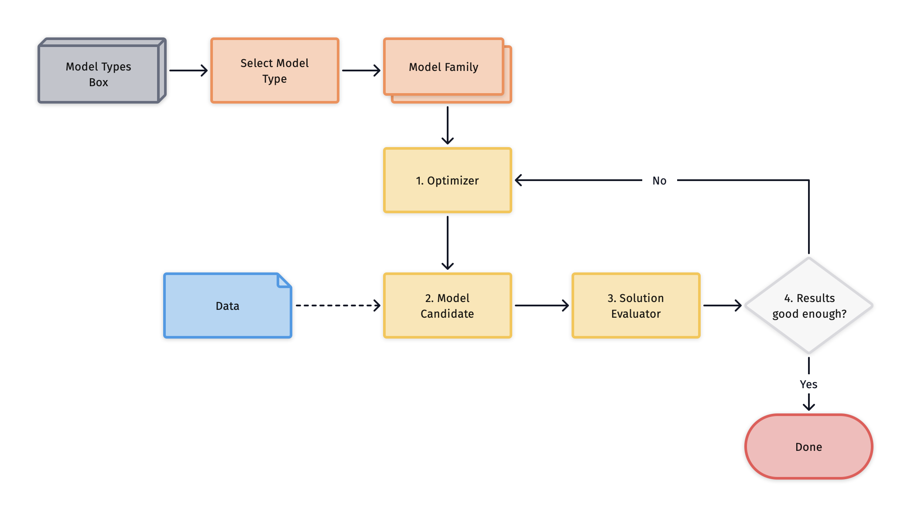
Components of a learning system

Slide 6

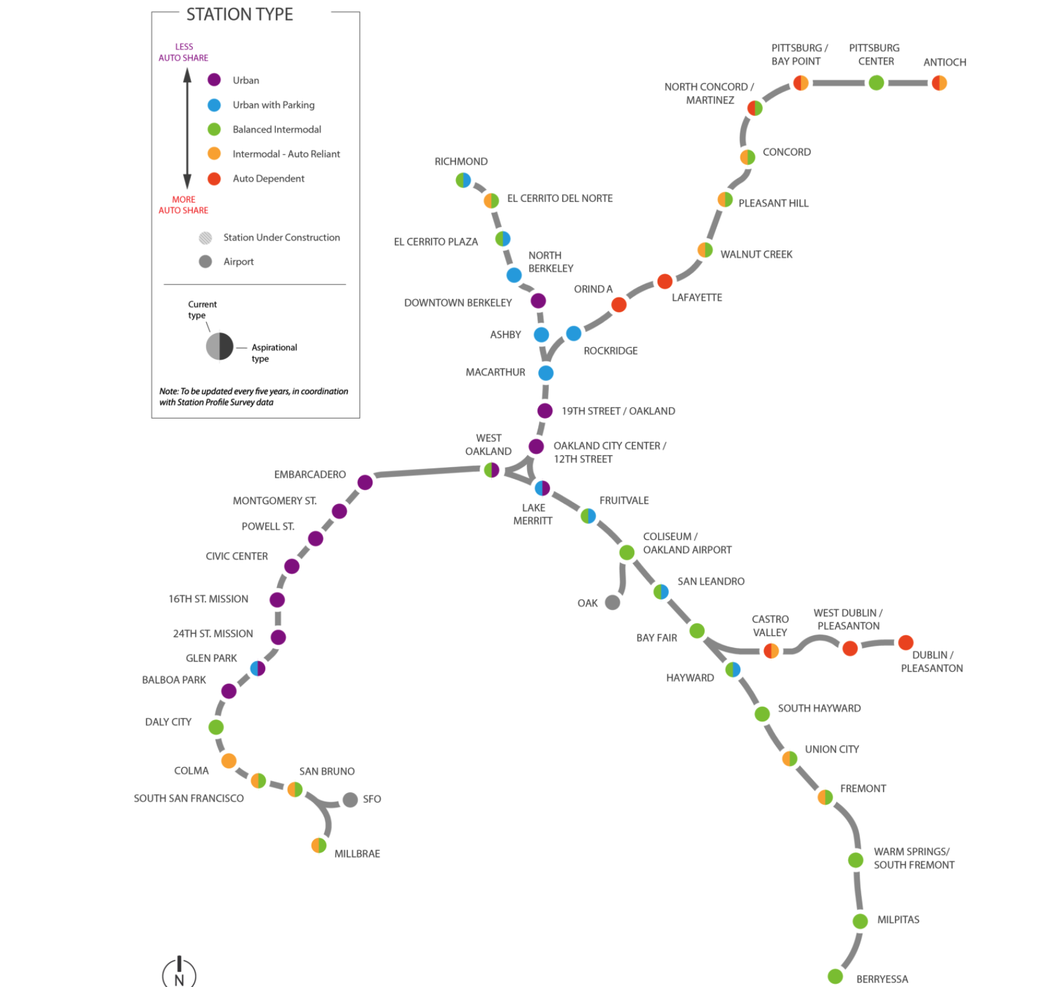
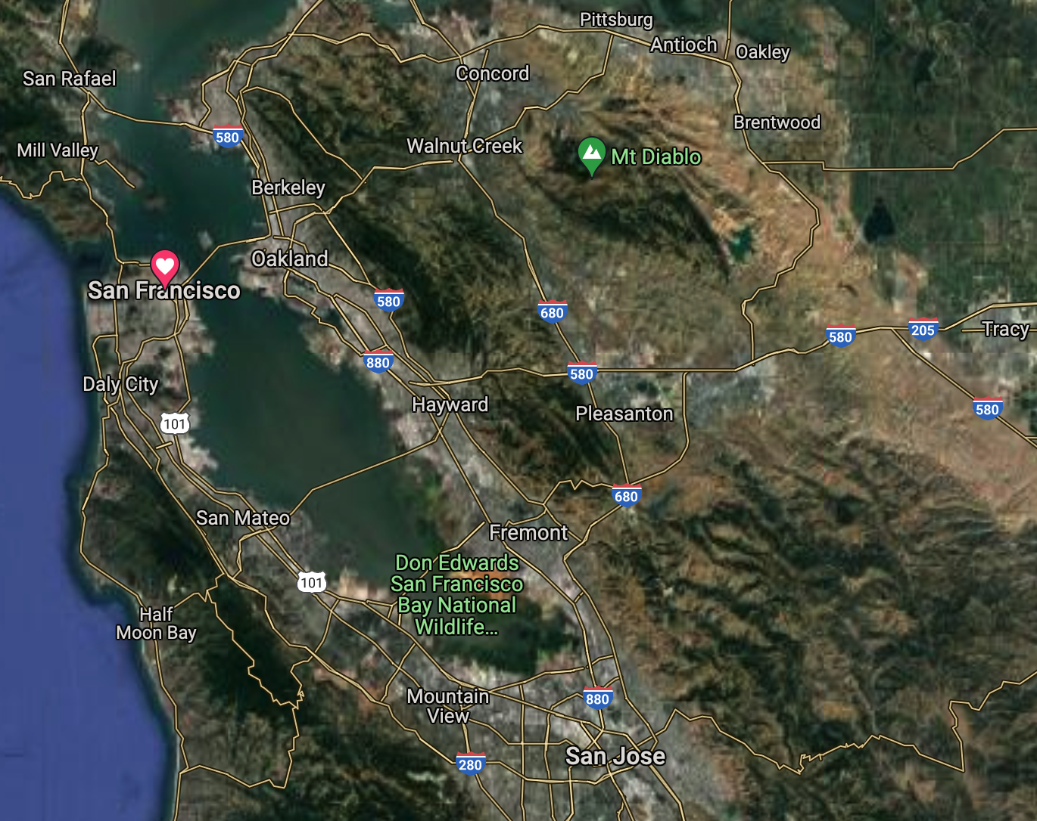
Why do we need models?

Slide 7
Computational Models
Optimization Models
Objective function maximize/minimize
Solutions limited by a set of constraints.
Simulation Models
Simulate the execution of real cases using randomizations
Statistical Models
Machine Learning models.

Slide 8
Linear Regression Model
The answer is a linear combination of input values.
Example:
Predict apartment rent based on the following:
- Number of bedrooms (beds)
- Number of bathrooms (baths)
- Neighborhood ‘score’: number from 1 to 5 (zone)
After training, we could have learned the formula:
Rent = (342 * beds) + (159 * baths) + (250 * zone)

Slide 9
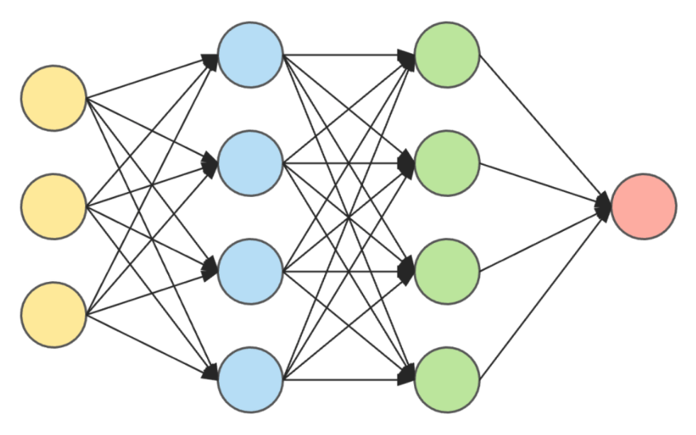
Neural Networks Model (Deep Learning)
The model contains several ‘layers’ of interconnected neurons.
Example:
Image processing, natural language, etc.
Recognize the zip code handwritten in a letter.

Slide 10
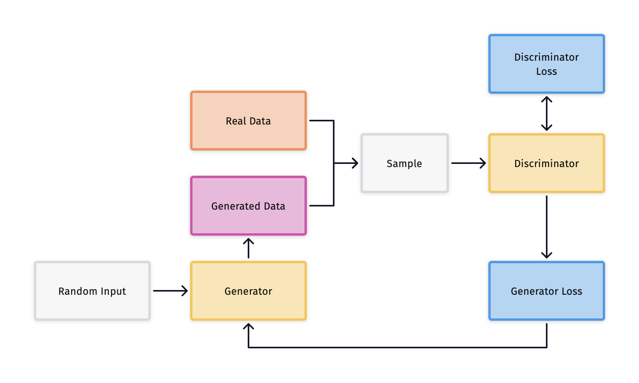
Generative Adversarial Networks
Example:
Generate art paintings, text content, music etc.

Slide 11
Ensemble Models
- Ensemble ML models, build a set of ML models internally and use some form of a ‘voting’ system to determine the final result.
1. Bagging is an ensemble algorithm that selects random subsets of a dataset and builds models for each of them and combines the results using plain voting.
2 Random Forest is an extension of Bagging that selects subsets of rows and subsets of columns and builds models that are later combined.
3. Boosting is another ensemble algorithm that builds models in sequence, and the input of the next model is the ‘error’ (delta) from the previous one.

Slide 12
Terminology
Model (in ML/Ai) A mathematical construct we use to learn and make inferences about data.
Target Variable / Label The value (‘model output’) we are trying to predict.
Predictor The inputs for the model make predictions.

Slide 13
Terminology (cont. 1)
Feature = A data element or some ‘derivation of it’ used as a predictor.
Label = A function
Cost function = A function that defines the ‘price’ of each error the model makes. The goal is to minimize the average price we pay for errors.
Model Parameter = An unknown internal value that will be ‘optimized’ during the training phase.

Slide 14
Terminology (cont. 2)
Model Hyperparameter = A parameter that the modeler provides to the model.
Example: Number of nodes in a deep learning model layer.
Model Drift (Prediction Drift) = When prediction performance decay from the initial levels.
Data Drift = When the data or data distributions change. (Enables early detection of model drift)

Slide 15
Goal of Model Training
Use data to build an artifact (model) that captures that data's general trends.
Generalization is extracting the underlying knowledge beyond items in the ‘current data set.’

Slide 16
Bias / Variance Trade off
Bias: A model with high bias is more ‘stubborn’ and pays less attention to the dataset. It tends to oversimplify.
(Underfit = not adapted enough)
Variance: A model with high variance pays too much attention to the data. A single record can shift the model wildly.
(Overfit = adapted too much)

Slide 17
Our goal is to find the sweet spot in the Bias/Variance blend.
Underfit
Overfit
To much
Bias
Right
balance
To much
Variance
Generalization

Slide 18
Bias / Variance Trade off
How to control Bias and Variance?
Pick models that are less flexible but can capture the problem.
Ex: linear model vs. polynomial model
- Regularization
Regularization can be implemented by putting a ‘price’ on model complexity. Simpler models will be preferred unless the errors are a lot larger.
The are other regularization techniques.
(covered in future sessions)

Slide 19
ML Model Lifecycle
1
Data Acquisition
2
Exploratory Data Analysis
3
Model Selection
Data Hygiene
4
Feature Engineering
Model Training
5
6
Model Performance
Monitoring
Model
Validation
7
Learnings
Feedback
Deployment

